Slide 1


HOMEHIVE
DBMS PROJECT GROUP 06
Team Members:
AHANYA MARIAM POKKAMTHANAM, 2241107
ANTONY CHANDY DOUGLAS, 2241117
RUCHIT DHANUKA, 2241150
Under the Guidance of:
Dr.Sagaya Aurelia
MISSION
CHRIST is a nurturing ground for an individual’s holistic development to make effective contribution to the society in a dynamic environment
VISION
Excellence and Service
CORE VALUES
Faith in God | Moral Uprightness
Love of Fellow Beings
Social Responsibility | Pursuit of Excellence

Slide 2
CHRIST
Deemed to be University
CONTENT
1.ABOUT
2.OBJECTIVE
3.FUNCTIONALITY
4.EXISTING SYSTEM & LIMITATIONS
5.UI MODULES
Admin Login
User Login
Home Page
Categories
Sub Categories
Profile
Cart
Order
6.DATABASE
Database Schema
ER Diagram
Excellence and Service

Slide 3
CHRIST
Deemed to be University
HOMEHIVE
HomeHive emerges as an innovative and comprehensive online marketplace system for different household products that blends traditional e-commerce features with cutting-edge functionalities to deliver an unparalleled shopping experience. It stands out by seamlessly integrating unique features like cryptocurrency payments, shared carts, group buying, and offering a range of functionalities akin to established e-commerce platforms while adding its distinct touch.
KEY FEATURES
Cryptocurrency Payments:
HomeHive introduces cryptocurrency payments.
Allows secure and decentralized transactions.
Shared Carts:
Simplifies shopping with shared carts.
Enables collaborative curation for families or groups.
Excellence and Service

Slide 4
CHRIST
Deemed to be University
OBJECTIVE
Enhanced Shopping Experience:
HomeHive is committed to providing a user-centric interface, focusing on ease of navigation and a personalized shopping journey.
Diverse Product Spectrum:
The platform houses a vast array of products across multiple categories, catering to a wide range of consumer needs and preferences.
Pioneering Features:
HomeHive's distinguishing features include cryptocurrency payment integration, shared carts allowing collaborative shopping experiences.
Excellence and Service

Slide 5
CHRIST
Deemed to be University
FUNCTIONALITY
User Management:
Registration, login, and profile management.
Password security and authentication tokens.
Roles and Permissions:
Admin, seller, buyer roles.
Permissions based on roles.
Product Management:
Add, edit, delete products.
Categorization, attributes, variations.
Catalog management and bulk product upload.
Search and Filter:
Advanced search with filters (categories).
Shopping Cart:
Add/remove items, view cart, manage quantities.
Calculate totals and taxes.
Checkout Process:
Address validation, multiple payment options.
Order summary and confirmation.
Order Management:
Tracking order status updates.
Access to past order history.
Communication:
Messaging between buyers and sellers.
Notifications for order status and promotions.
Excellence and Service

Slide 6
CHRIST
Deemed to be University
EXISTING SYSTEM
Wayfair:
Online retailer for furniture, home decor, and household goods.
Wide product range for various styles and budgets.
Bed Bath & Beyond:
Both online and physical stores.
Specializes in home goods like bedding, kitchenware, and decor.
Amazon Home:
Part of Amazon marketplace.
Extensive selection of home goods, including furniture and appliances.
LIMITATIONS
Cryptocurrency Integration:
Technical complexity due to diverse APIs and security concerns.
Compliance challenges with evolving regulations.
Technology Integration:
Significant resources needed for integrating innovative features.
Time, expertise, and development effort required.
Market Competition:
Standing out in e-commerce needs unique value propositions.
Aggressive marketing essential to compete with established platforms.
Excellence and Service

Slide 7
CHRIST
Deemed to be University
MODULES
Excellence and Service

Slide 8
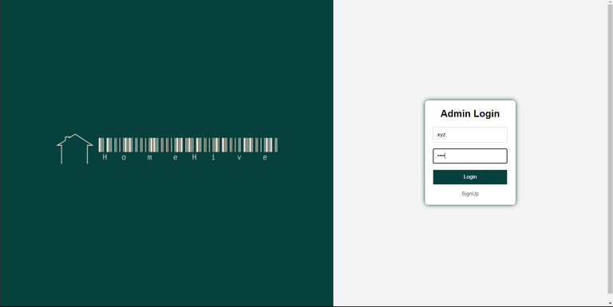
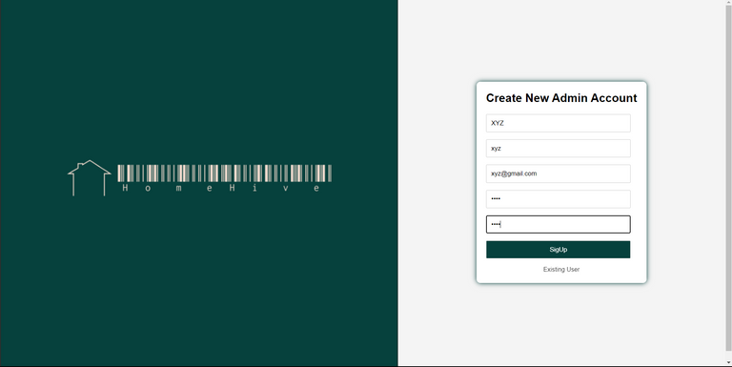
CHRIST
Deemed to be University
Admin Login
EXISTING ADMIN LOGIN
Login using username and password
Option to Create new Account
CREATE NEW USER ACCOUNT
Create Username,
Add email
Create password
Password confirmation
Excellence and Service

Slide 9
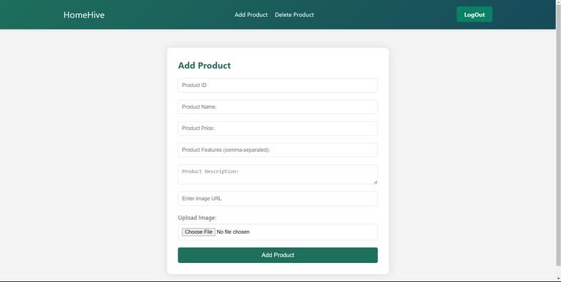
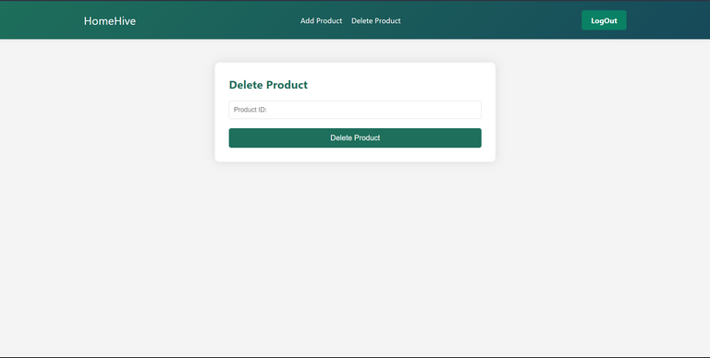
CHRIST
Deemed to be University
ADD PRODUCT and DELETE PRODUCT
Add/Delete product page
Accesible by the Admin after login
ADD PRODUCT:
ID,
NAME,
FEATURES,
DESCRIPTION,
IMAGE URL
DELETE PRODUCT:
Only ProductID is required to delete a product from the database.
Excellence and Service

Slide 10

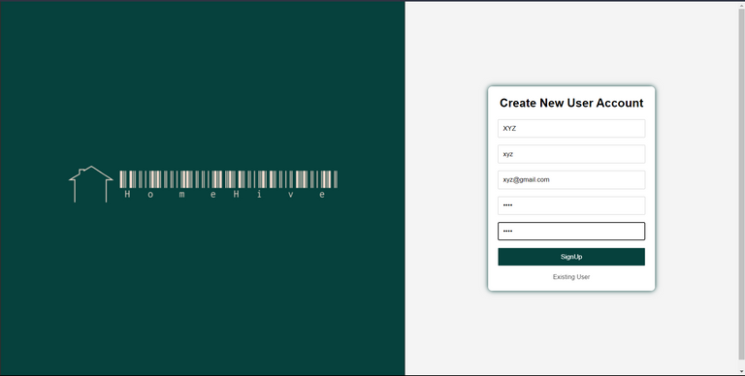
CHRIST
Deemed to be University
USER LOGIN
EXISTING USER LOGIN
Login through username and password.
Option to Create new account
CREATE NEW USER ACCOUNT
Create Username,
Add email
Create password
Password confirmation
Excellence and Service

Slide 11

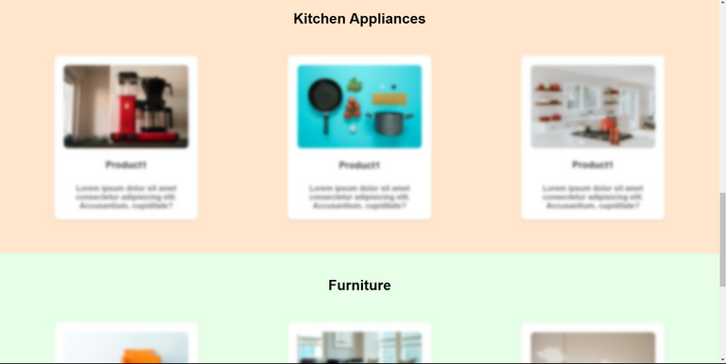
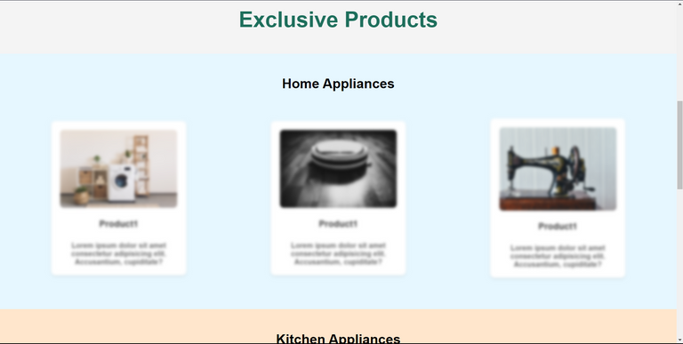
CHRIST
Deemed to be University
HOME PAGE WHEN THE USER IS NOT LOGGED IN
Simple UI
Features are not accesible
User login is necessary to access features
Features are Blured
Option to login or sign up
Excellence and Service

Slide 12

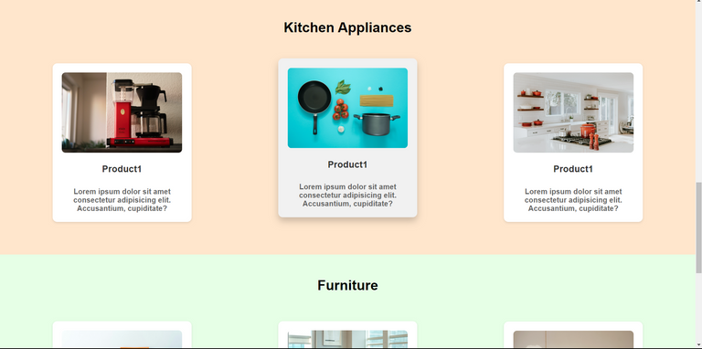
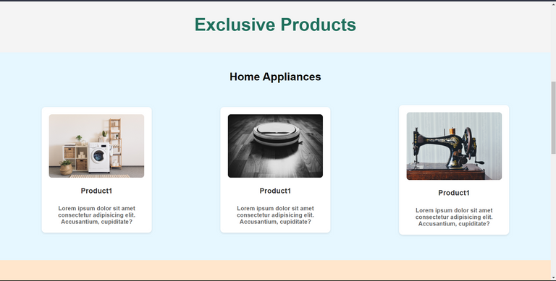
CHRIST
Deemed to be University
HOME PAGE WHEN THE USER IS LOGGED IN
Simple UI
Easy to use
Minimalistic
Interesting
3 Exclusive products in each category
Excellence and Service

Slide 13


CHRIST
Deemed to be University
CATEGORIES
Browse through available categories
Available Categories:Home Appliances, Furniture, Kitchen Appliances
Each category links to a different page, with related products
Category page contains: Product listings, Image and Price.
Excellence and Service

Slide 14
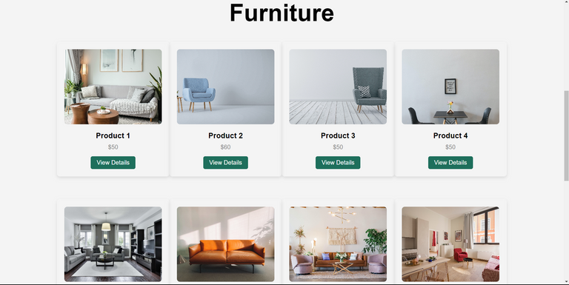
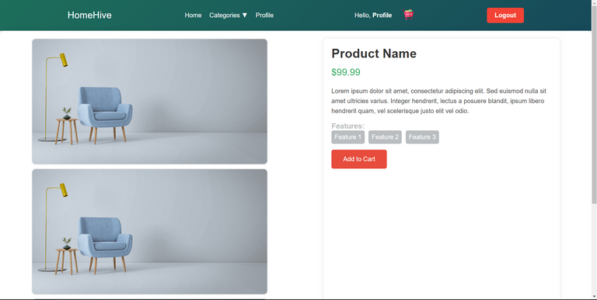
CHRIST
Deemed to be University
PRODUCTS
PRODUCT LISTINGS
Variety of Products
Browse through Products
PRODUCT PAGE
Product Name
Product Details
Features
Price
Add To Cart
Quantity
Excellence and Service

Slide 15
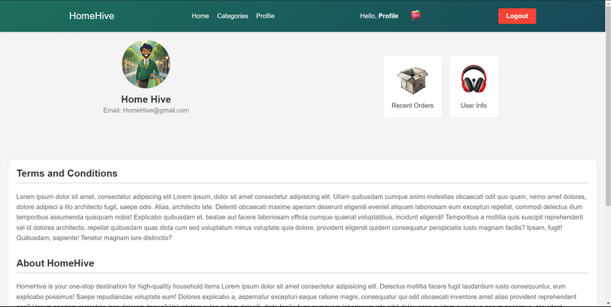
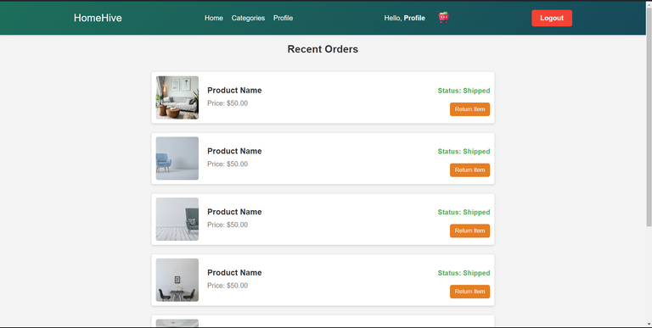
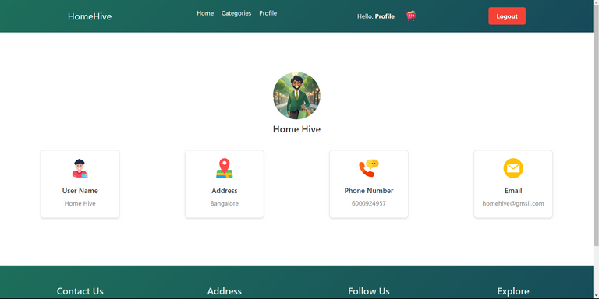
CHRIST
Deemed to be University
Profile and Sub Profile
PROFILE
RECENT ORDERS
Products, Date ordered, Return option.
CONTACT US
Contains contact information
HomeHive email
Phone number
Excellence and Service

Slide 16
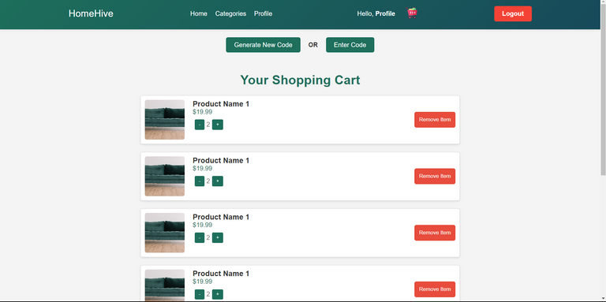
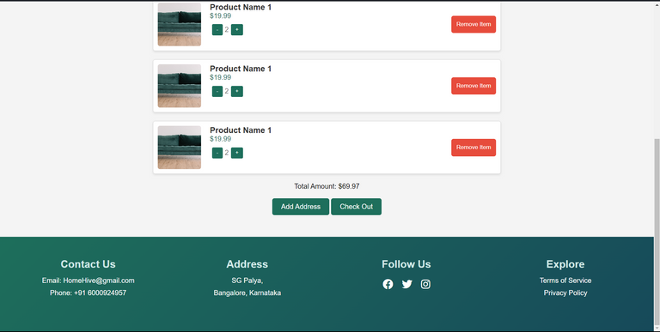
CHRIST
Deemed to be University
SHOPPING CART
SHOPPING CART
Generate Code
Enter Code
List of products
Add Address
Checkout
Excellence and Service

Slide 17
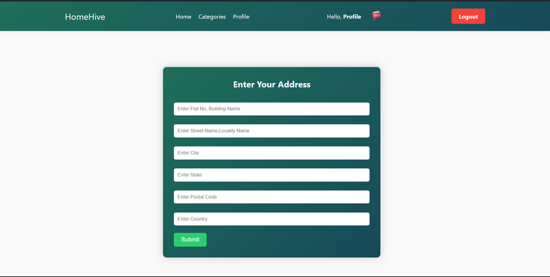
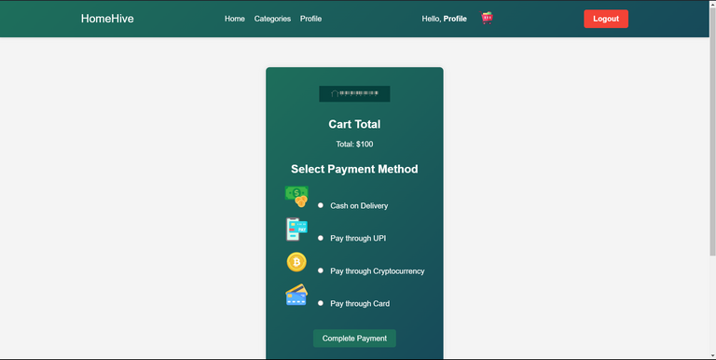
CHRIST
Deemed to be University
ORDER
ADD ADDRESS
Address line 1
Address line 2
City
State
Postal Code
Country
PAYMENT MODE
Cart Total
Cash on Delivery
UPI
Cryptocurrency
Cards
Excellence and Service

Slide 18
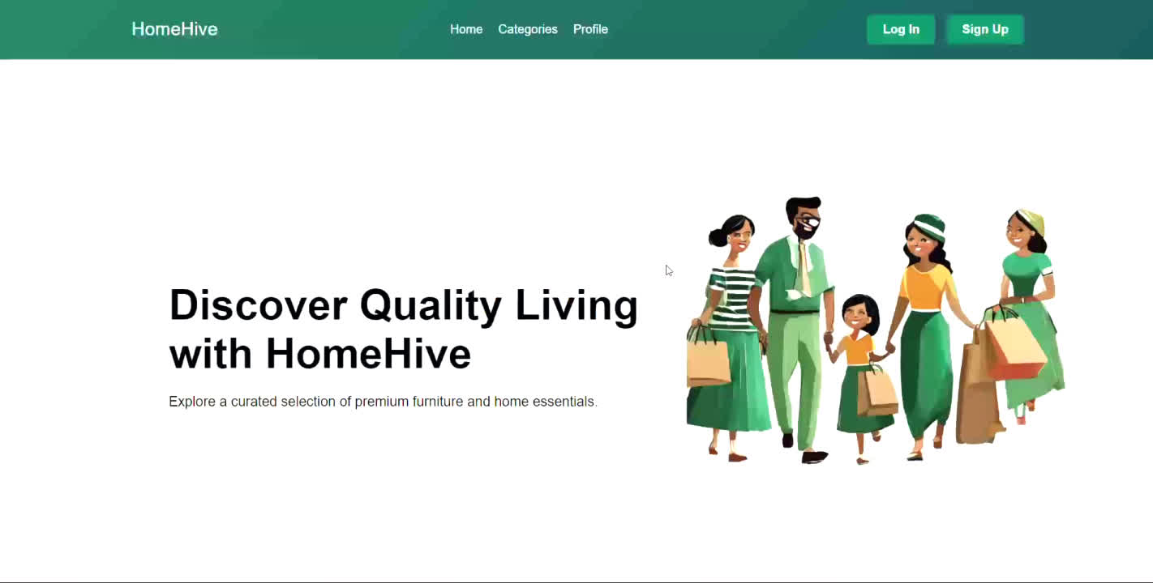
CHRIST
Deemed to be University
HOW TO PLACE AN ORDER
Excellence and Service

Slide 19
CHRIST
Deemed to be University
DATABASE
Excellence and Service

Slide 20
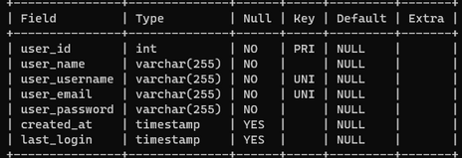
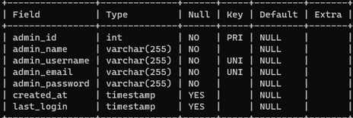
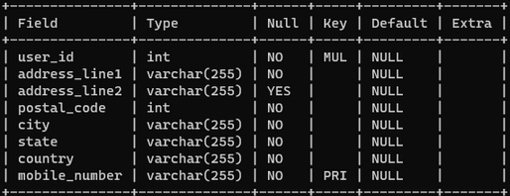
CHRIST
Deemed to be University
DATABASE
USER LOGIN
ADMIN LOGIN
USER ADDRESS
Excellence and Service

Slide 21
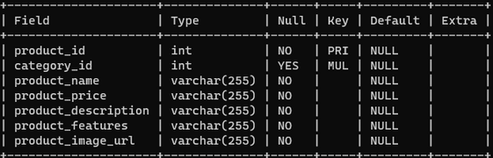
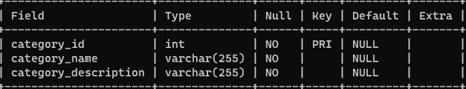
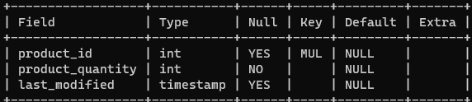
CHRIST
Deemed to be University
DATABASE
PRODUCT
PRODUCT CATEGORY
PRODUCT INVETORY
Excellence and Service

Slide 22
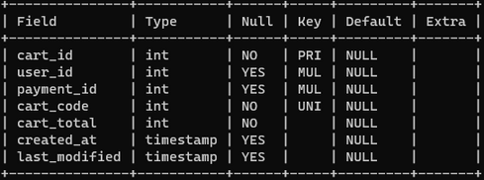
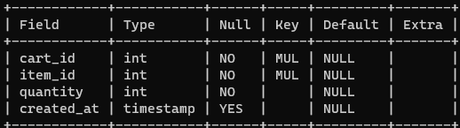
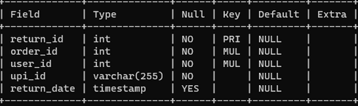
CHRIST
Deemed to be University
DATABASE
CART
CART ITEMS
RETURN
Excellence and Service

Slide 23
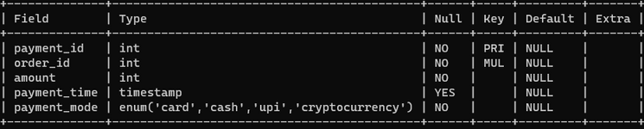
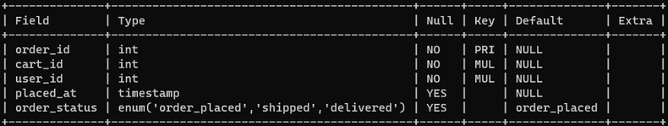
CHRIST
Deemed to be University
DATABASE
PAYMENT
ORDER
Excellence and Service

Slide 24
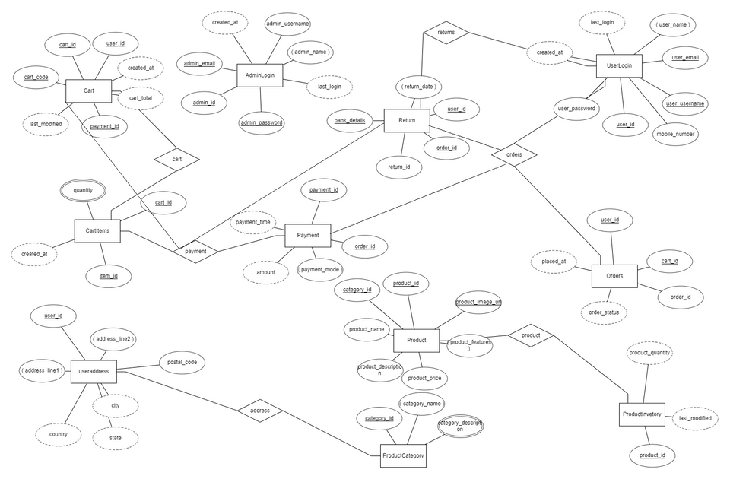
CHRIST
Deemed to be University
ENTITY-RELATION DIAGRAM
Excellence and Service

